Slide 1

Automobile Sales Analysis

Slide 2
Introduction:
The automobile industry has a rich history that dates back to the late 19th century.
Globally, several major automakers dominate the industry. Companies like Toyota, Volkswagen, General Motors, Ford, Honda, and BMW are among the largest and most influential players.
Vehicles are becoming increasingly connected, incorporating advanced infotainment systems, navigation, and communication technologies.
Different regions have unique market dynamics. For instance, Asia-Pacific is a key market with high production and sales, while Europe is known for its emphasis on fuel efficiency and strict emission standards.
The manufacturing processes have evolved with the use of robotics and automation in assembly lines, contributing to efficiency and precision.
The current automobile industry is filled with different types of vehicles with a variety of options and features which makes them standout from their competitors and boosts their sales.

Slide 3
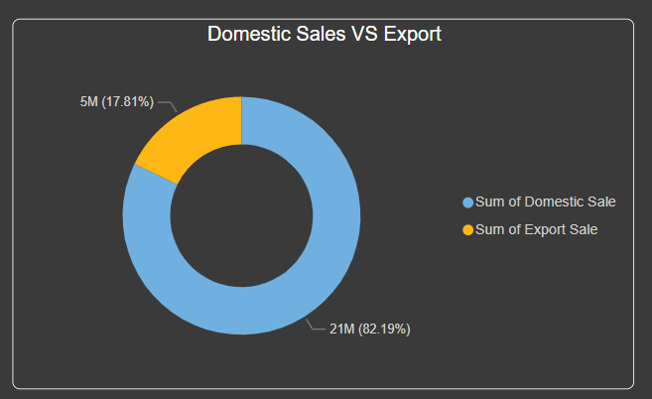
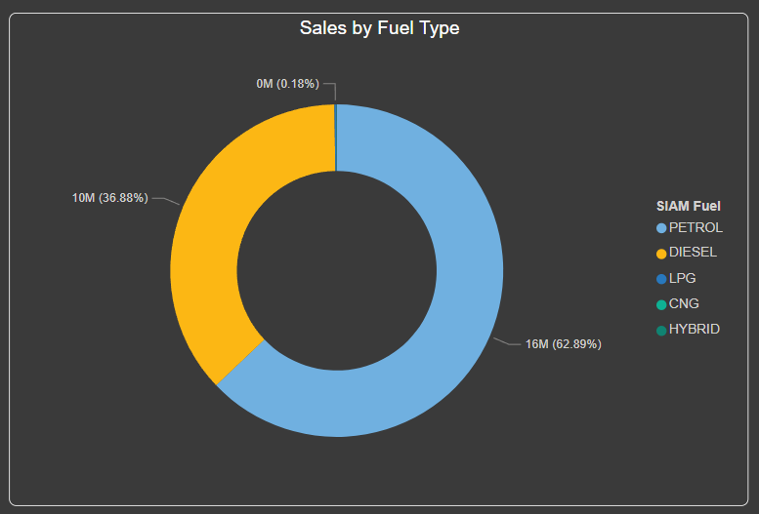
Data Analysis: General Analysis
Most of the profits are earned through domestic sales with the domestic sale percentage up to 82.19%
The Export sales are quite low compared to domestic sales where Domestic sales percentage is only up to 17.81%
The best selling Fuel type model is “Petrol” with nearly 63% of Sales followed by “Diesel” with nearly 39% of sales.

Slide 4
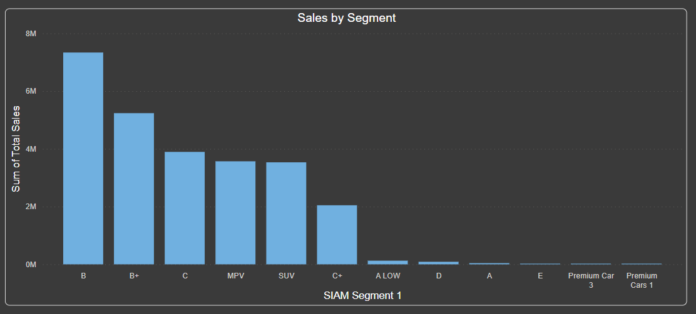
Data Analysis: Segment analysis
Best Selling segments: B, B+, C
Segments with lowest sales: Premium cars, A, E

Slide 5
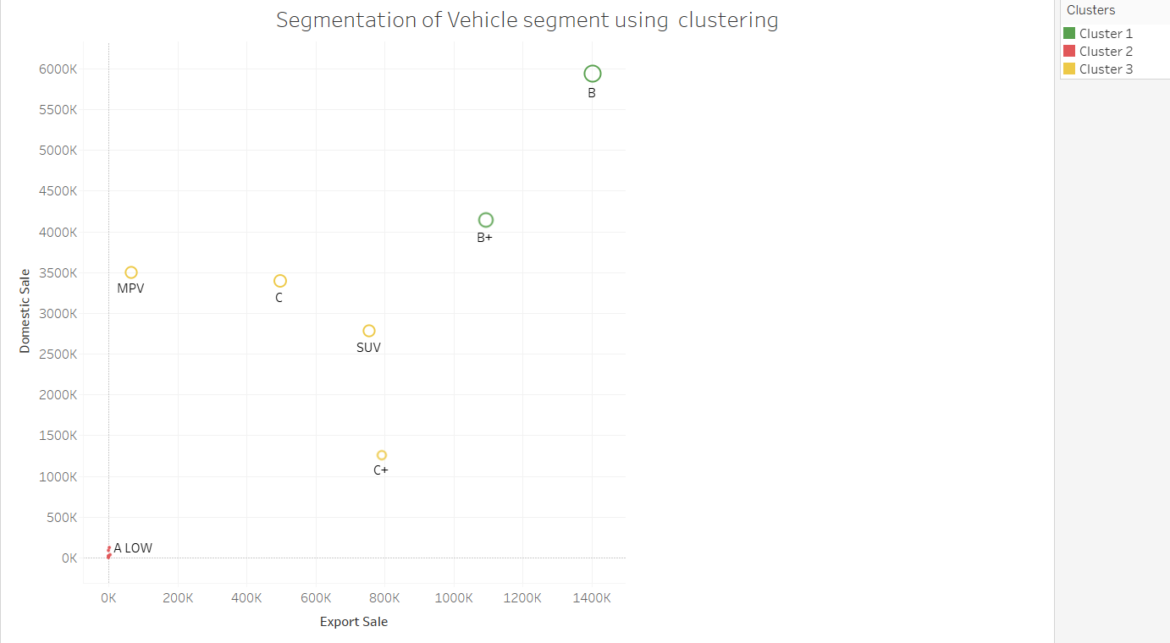
Data Analysis: Customer market segmentation
Using clustering algorithm to identify best performing, Average performing and poor performing vehicles based on segment
Cluster 1 : (B+, B) are the best performing segments
Cluster 2 : (Premium, A Low etc..) are the poor performing segments
Cluster 3 : (MPV, C, SUV and C+) are the average performing segments.

Slide 6
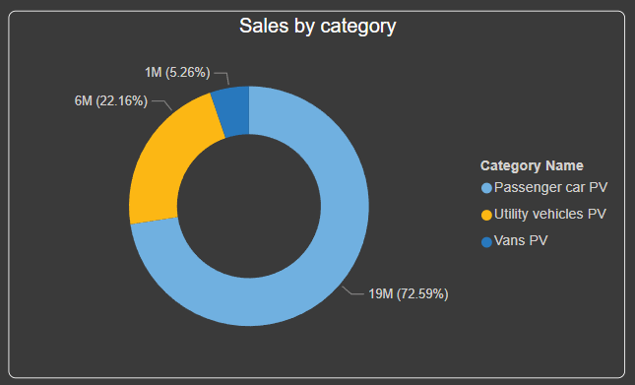
Data Analysis: Category analysis
The Best selling Category is Passenger car with nearly 73% of total sales.
The Category with lowest sales is the vans with 5.26% of total sales.

Slide 7
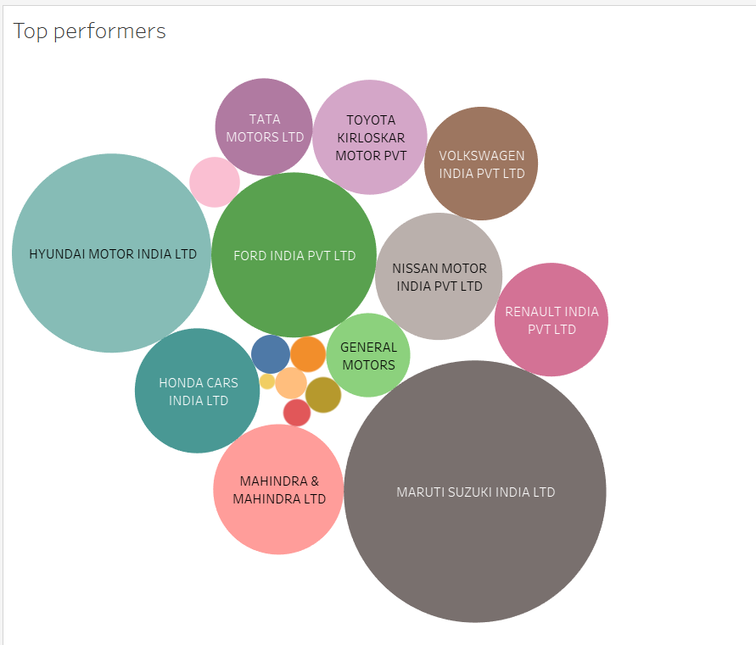
Data Analysis:
The Top performing companies are with the highest sales are Maruti Suzuki, Hyundai, Ford, Nissan, Honda, Mahindra & Mahindra, Nissan etc…
These companies have the highest number of average sales and Annual sales.

Slide 8
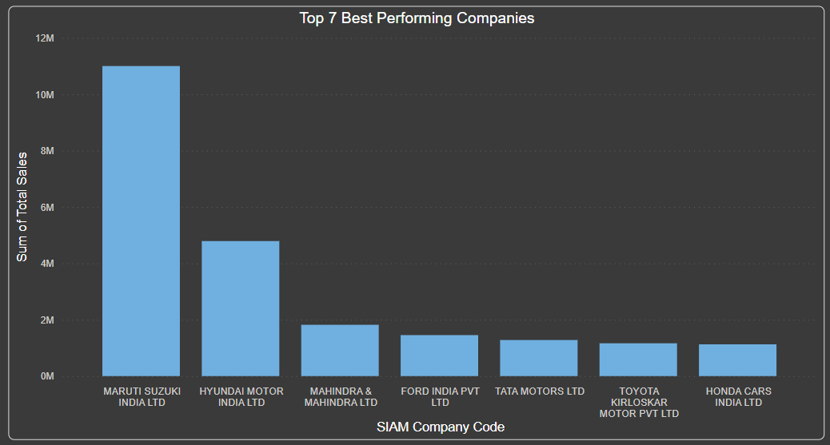
Data Analysis: Top 7 best Performing companies
Identified the top best performing companies with highest number of sales.
The top company was Maruti Suzuki with a total sales of over 10M car sales which is nearly double the amount sales compared to the second best performer Hyundai with total sales above 4M

Slide 9
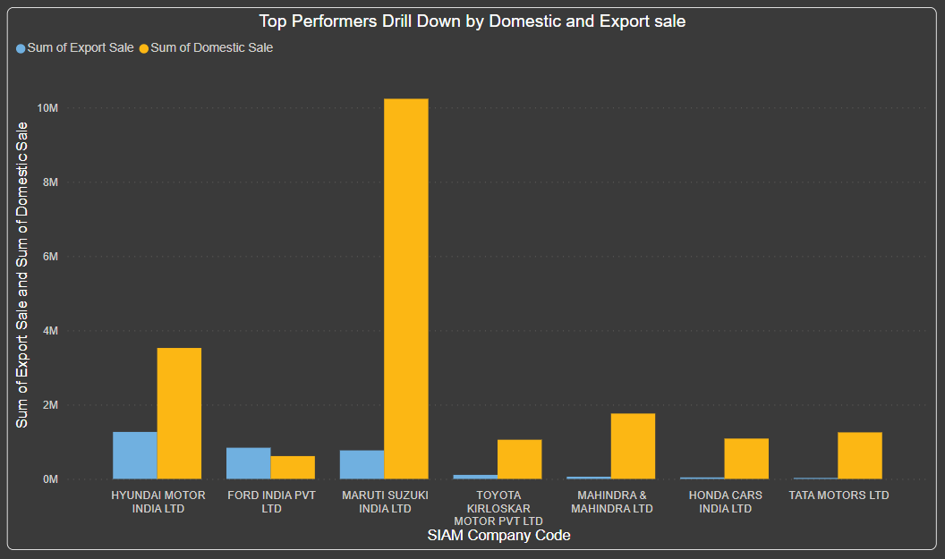
Data Analysis Best performer drill down:
Most of the best performers have high “Domestic Sales” which makes them as the best performing companies due to the high demand and high purchase of vehicles in Domestic market place

Slide 10
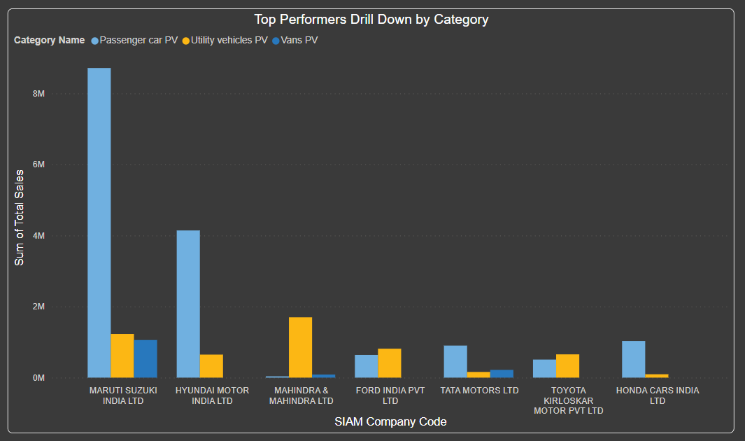
Data Analysis Best performer drill down:
The highest selling vehicle category is “Passenger car PV” followed by “Utility Vehicles”.
The visualization shows how the “Passenger car” and “Utility Vehicles” boosts the sales for these companies.
Maruti Suzuki has focused on all three segments while other companies are mostly focused on one or two categories which reflects in the sales numbers.

Slide 11
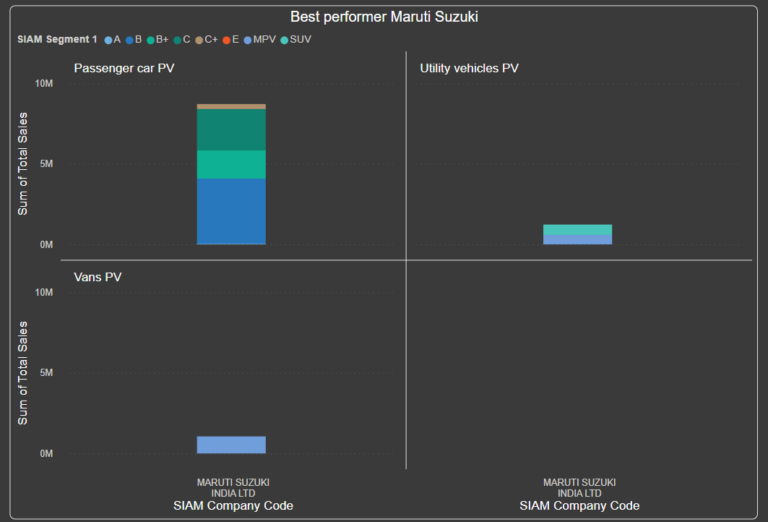
Analyzing the top performer “Maruti Suzuki”
The Company focuses on all three categories to cover a wide range of audience.
The Company focuses more on compact vehicles rather than costly premium models.
The Company sells more B, B+ and C segment vehicles which are affordable and covers more audience in the market place.

Slide 12
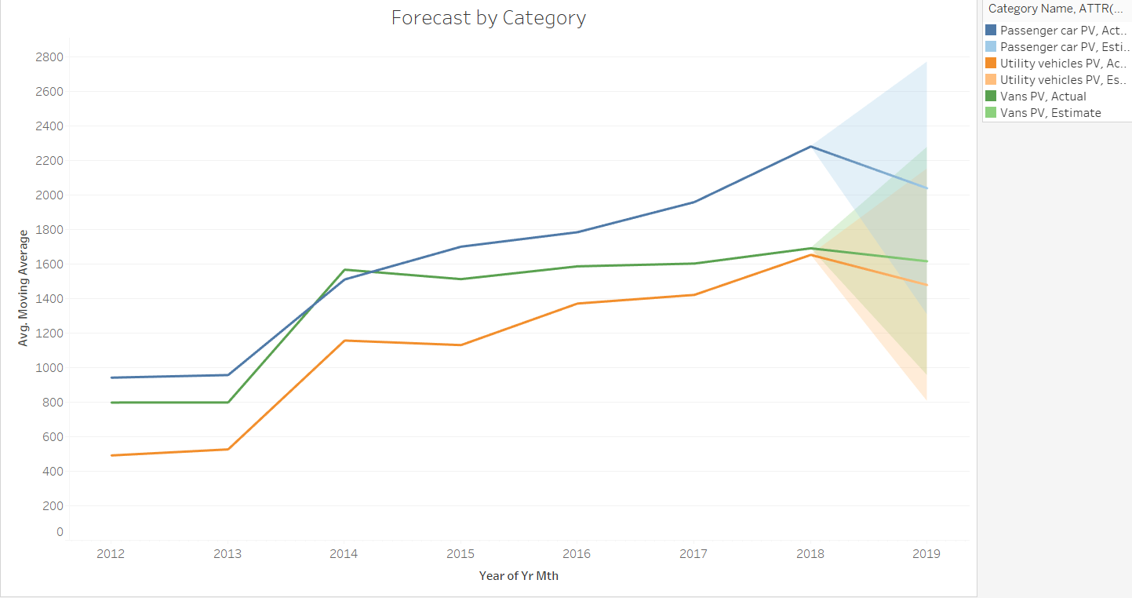
Forecast by Category using Moving Average.

Slide 13
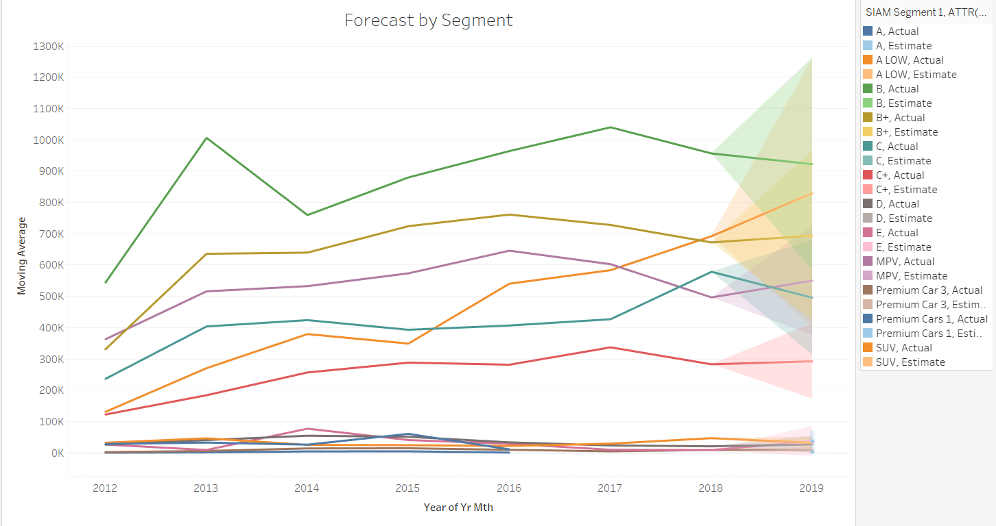
Forecast by segment using Moving Average

Slide 14
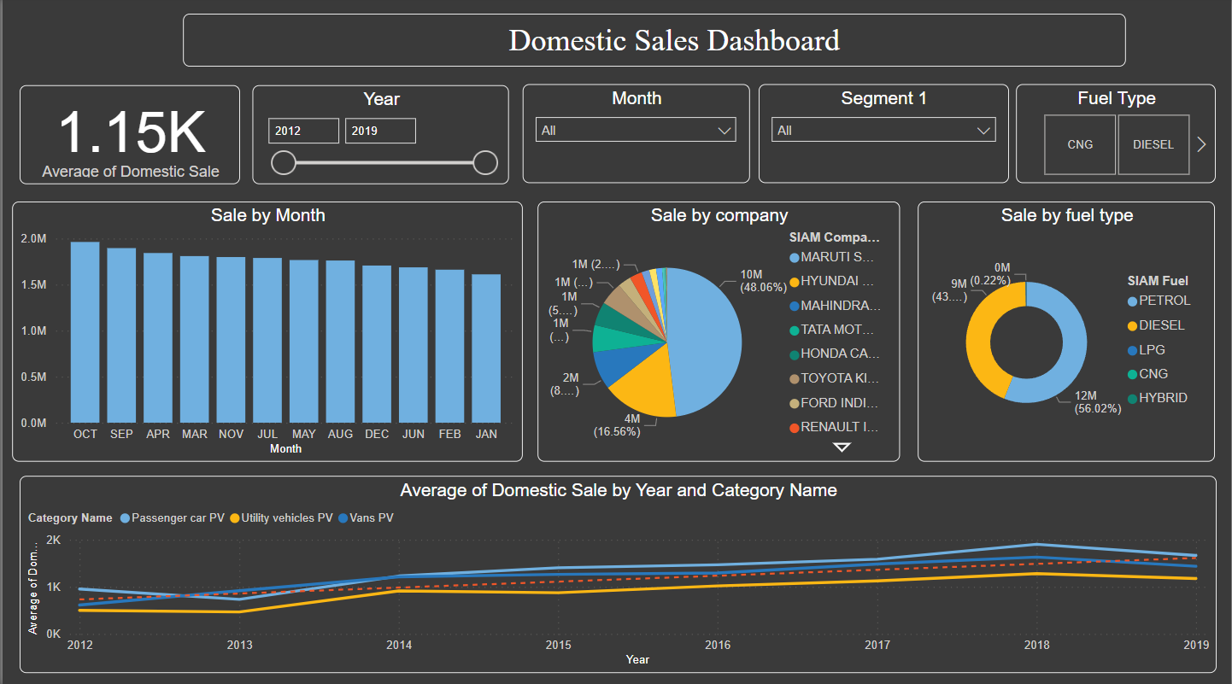
Domestic Sales Dashboard
Single page dashboard to track Domestic Sales

Slide 15
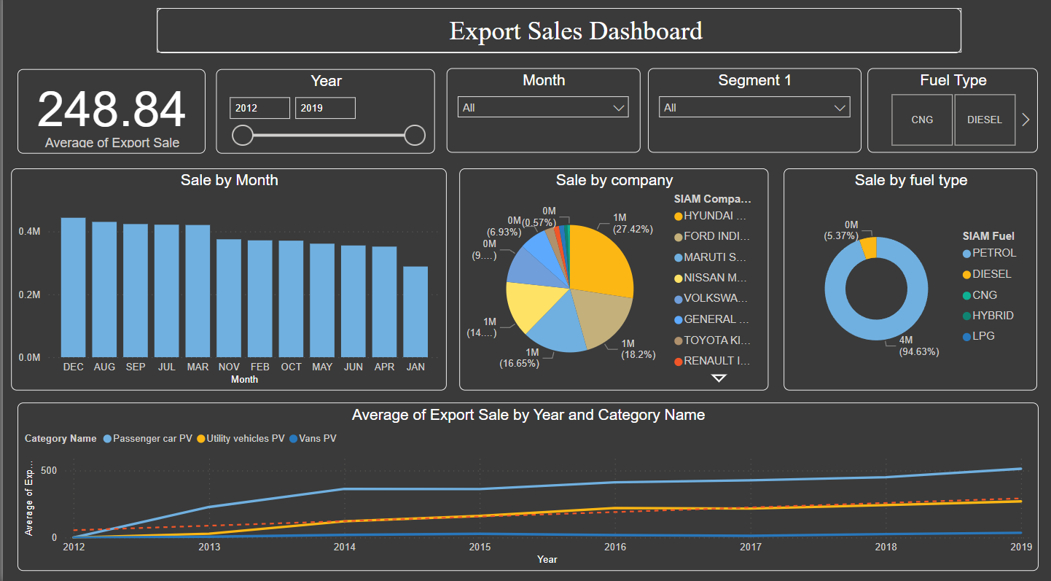
Export Sales Dashboard
Single page dashboard to track Export Sales

Slide 16
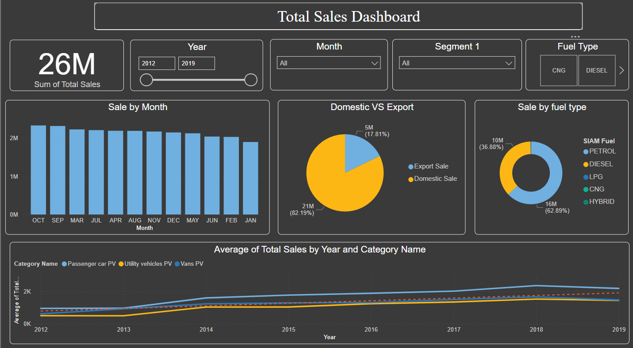
Total Sales Dashboard
Single page dashboard to track Domestic Sales

Slide 17
Conclusion:
Key Insights:
The rate of “Domestic Sales” is high compared to “Export” so the companies should focus more on Domestic Sales.
The companies should focus more on affordable vehicles segment like “Maruti Suzuki” as this segment has higher number of sales compared to premium models.
The companies should focus on all categories to attract more customers like “Maruti Suzuki” and most importantly on the passenger vehicle category to boost their sales.
The companies should focus more on vehicles fuelled by “Petrol” as most of the customers prefer Petrol fuelled vehicles.
The SUV vehicles have a recent growth in their sales rate and has become popular in the market

Slide 18

Thank You
Presented by: Ruban Shanmugam
Email: rubanshanmugam0@gmail.com

